Slide 1

Startup Investments Analysis
BDA 611: Visual Reporting and Communication
Andrea Garcia Fernandez
Mario Andres Alcaraz

Slide 2



Business Problem
Startup development is a cycle that involves constant effort from two sides: Entrepreneurs and Investors.
Identifying the trends, upcoming products/services and amount of money to invest is a constant challenge for investors.
As an entrepreneur, finding the right investors for your product, startup stage and location is a constant challenge.

Slide 3
Business Questions
Which markets received the most funding?
Are there any top locations for specific markets?
Where are the Angels, Venture Capitals and Private Equity Investing?

Slide 4
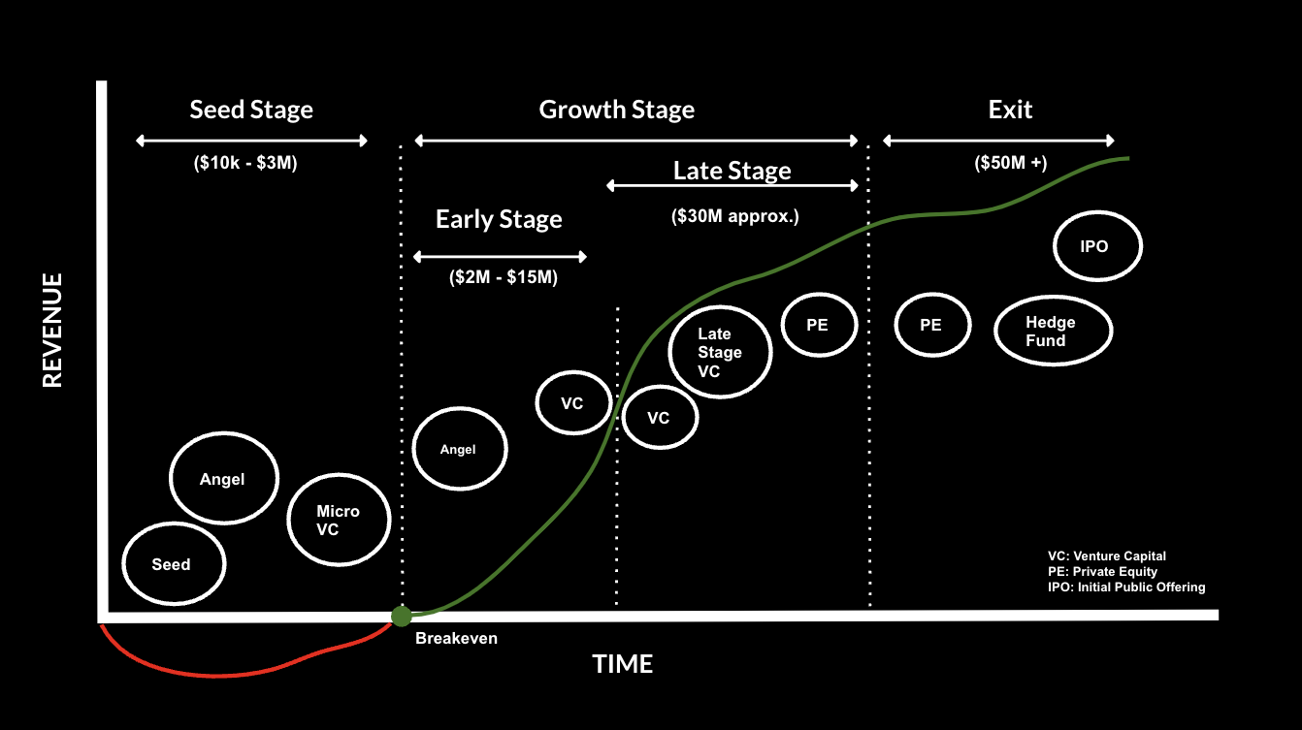
Startup Funding Cycle

Slide 5
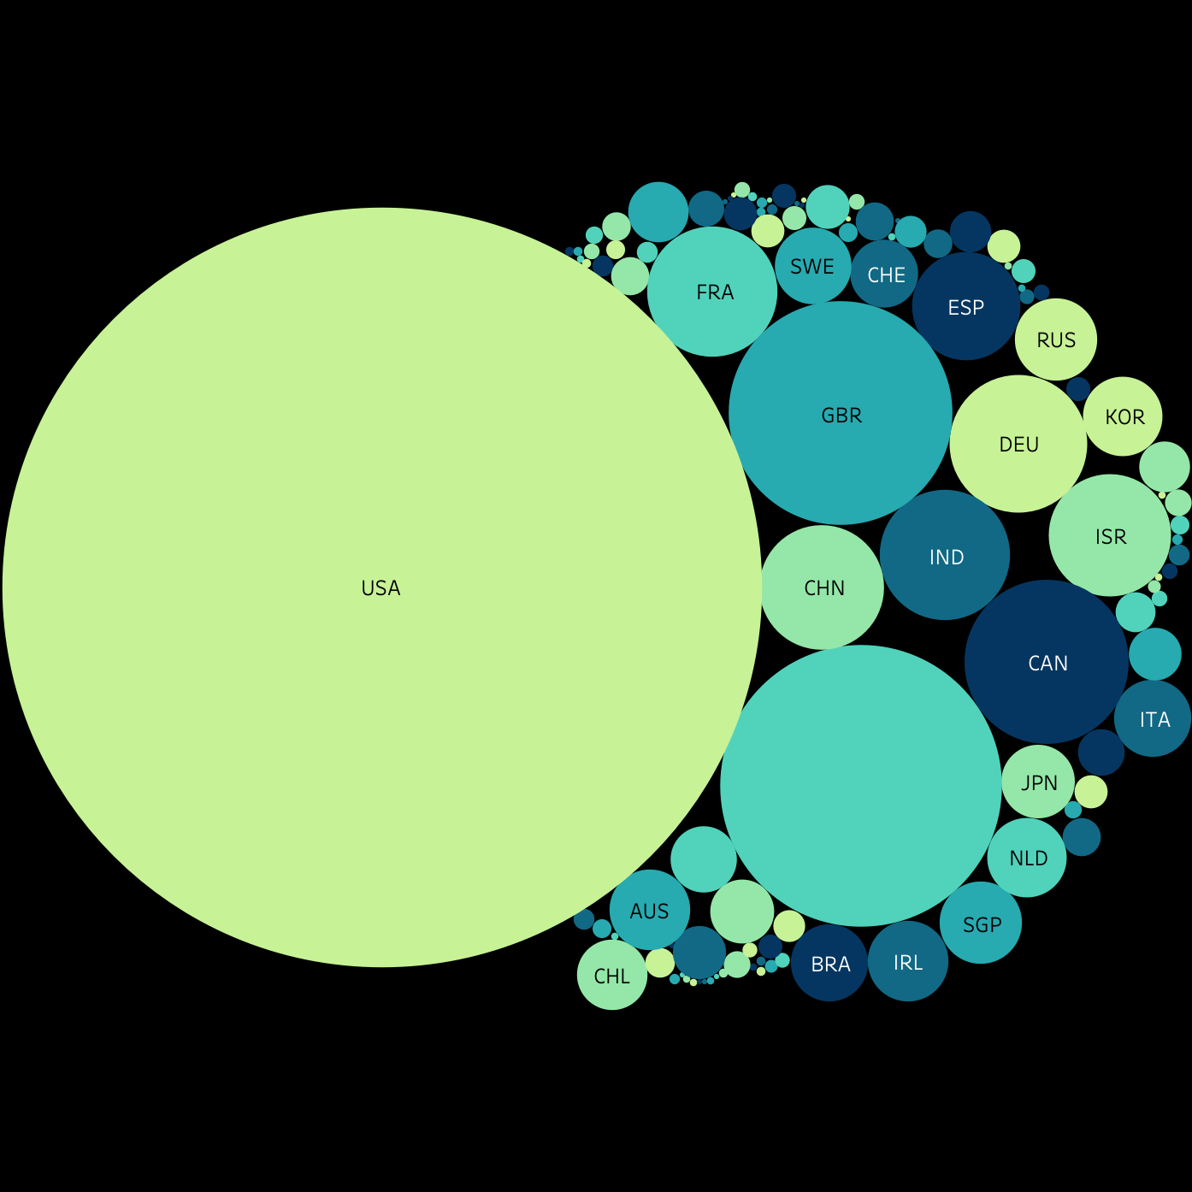
Data
Startup Name
Country
Founded Date
Funding Rounds
Seed Investment
Angel Investment
Venture Capital Investment
Private Equity Investment

Slide 6
Descriptive Analysis

Slide 7
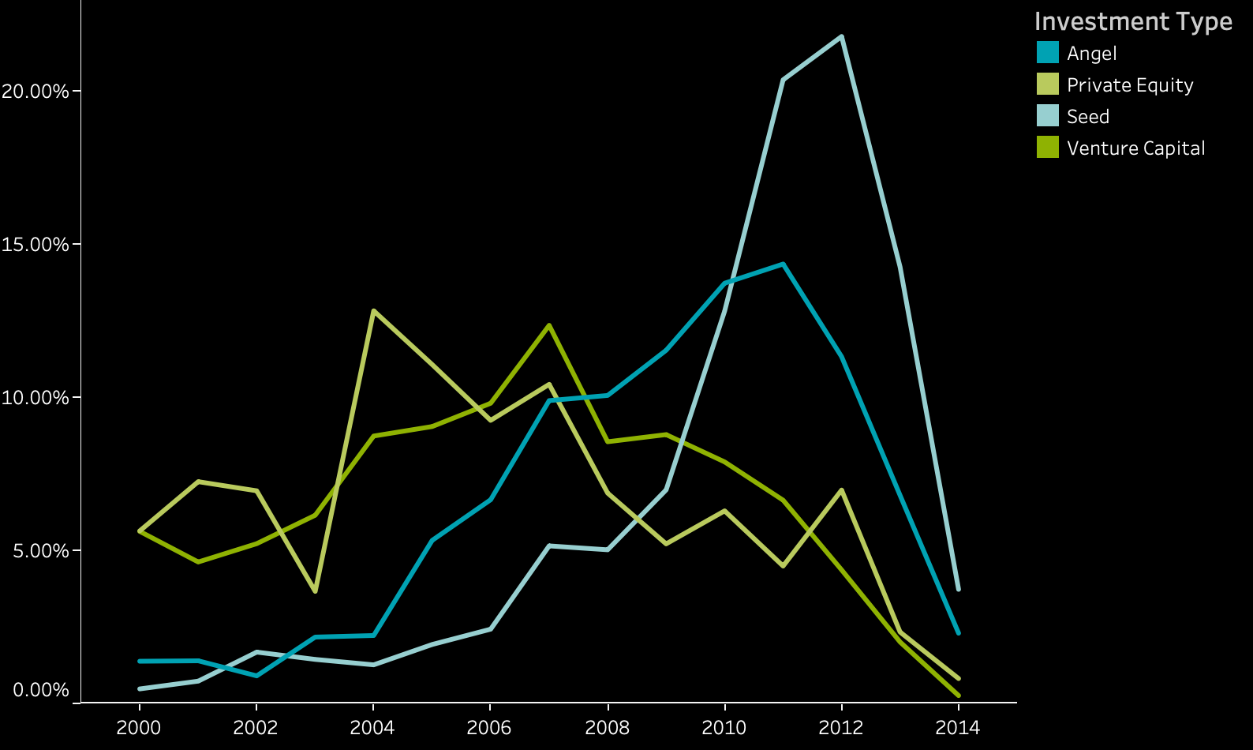
Investment Trend From 2000-2014

Slide 8
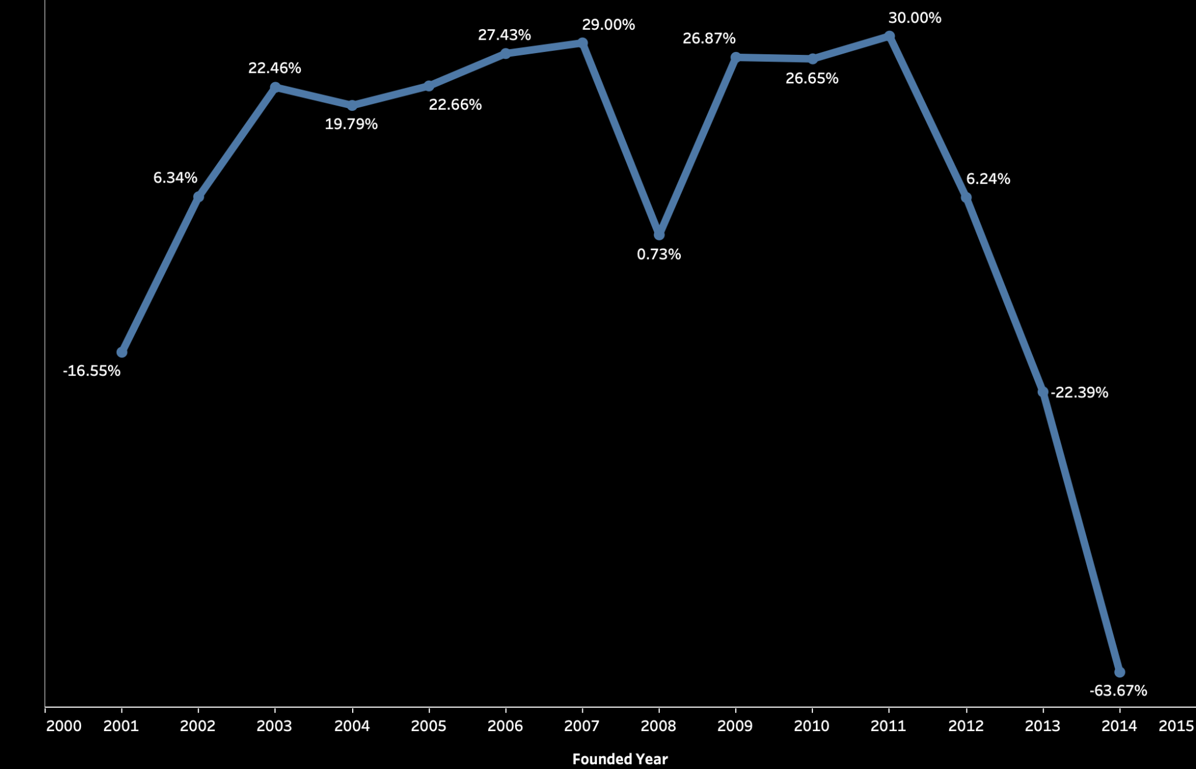
Rate of Startups Created Compared to Previous Year

Slide 9
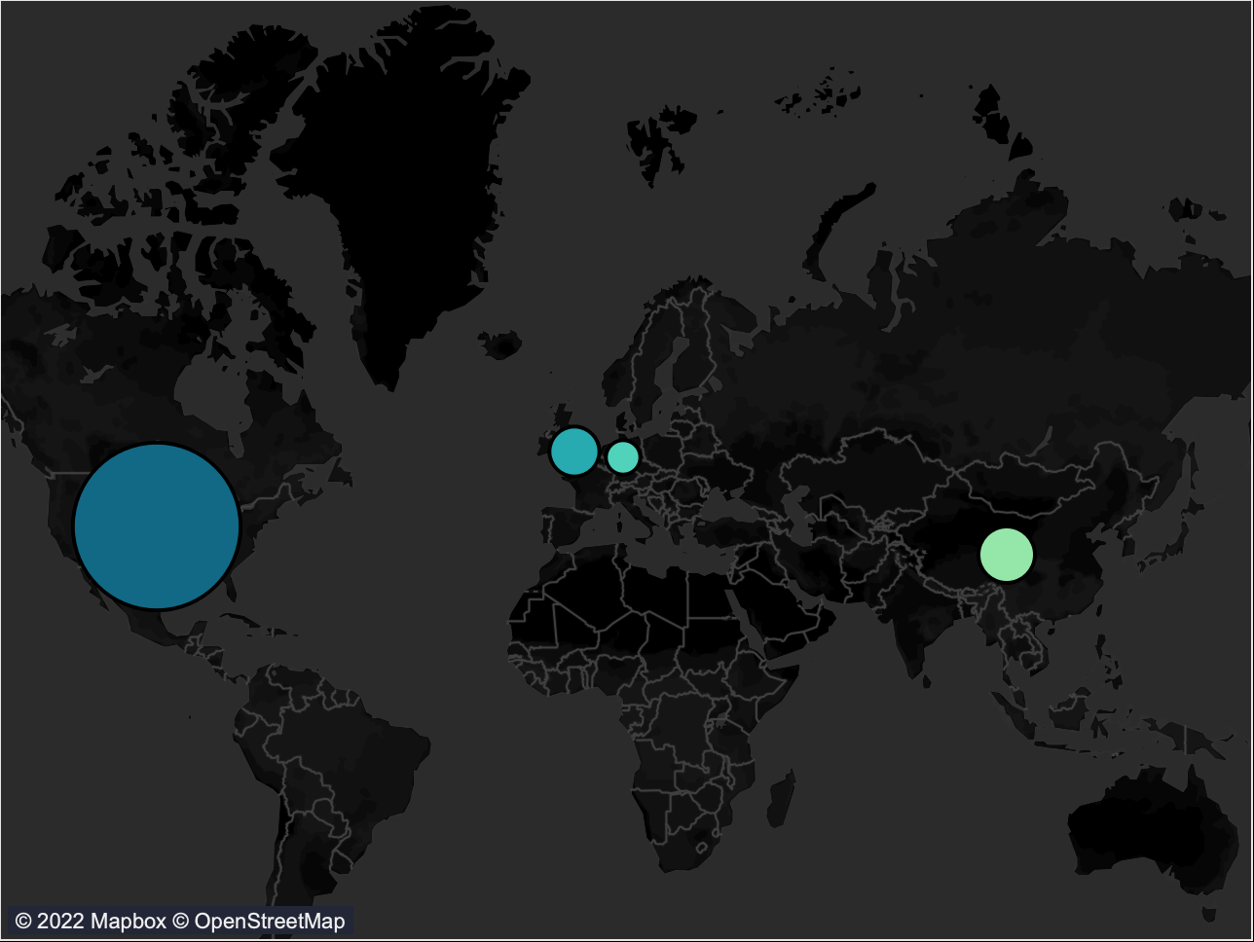
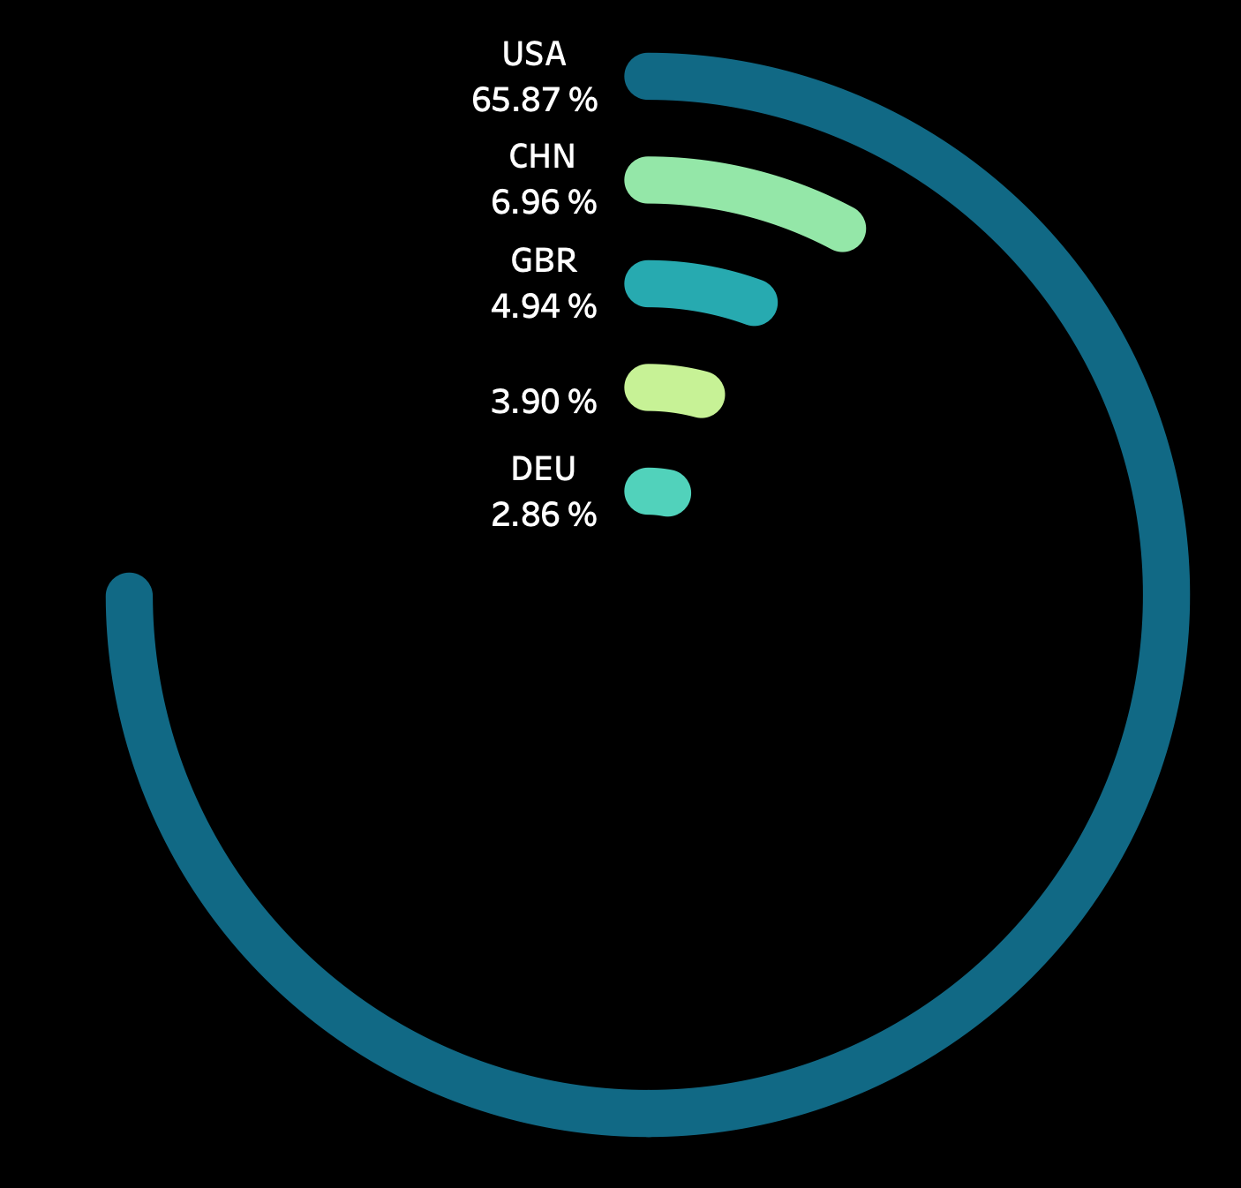
Private Equity After 2008

Slide 10
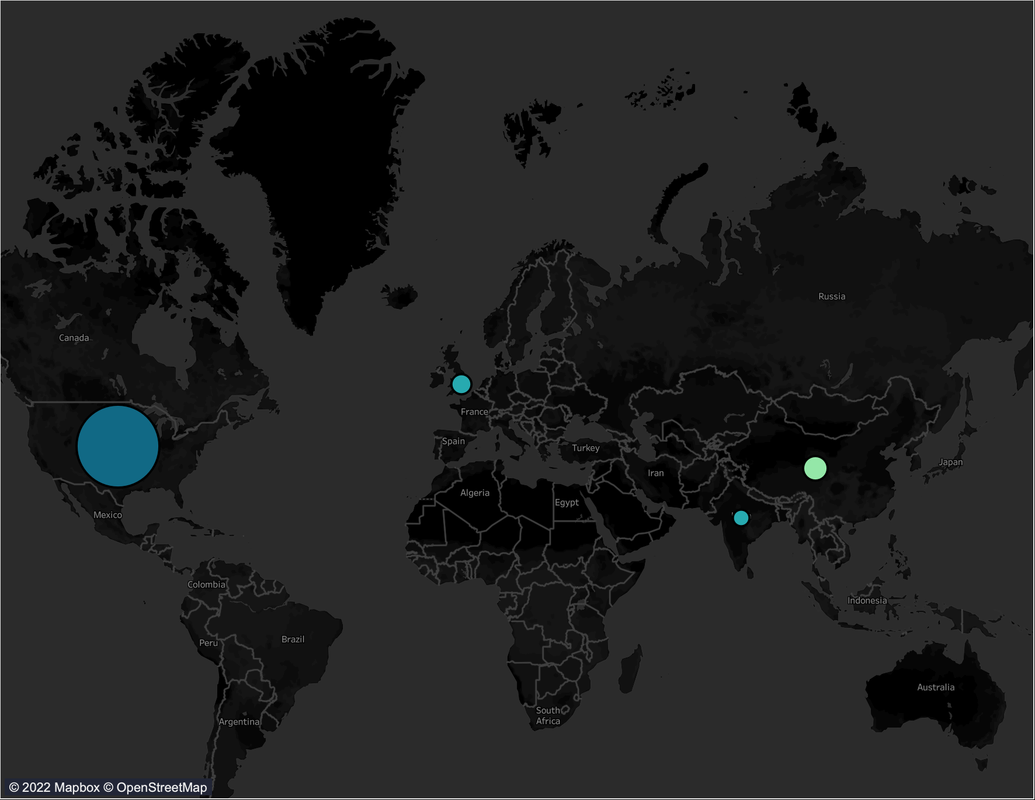
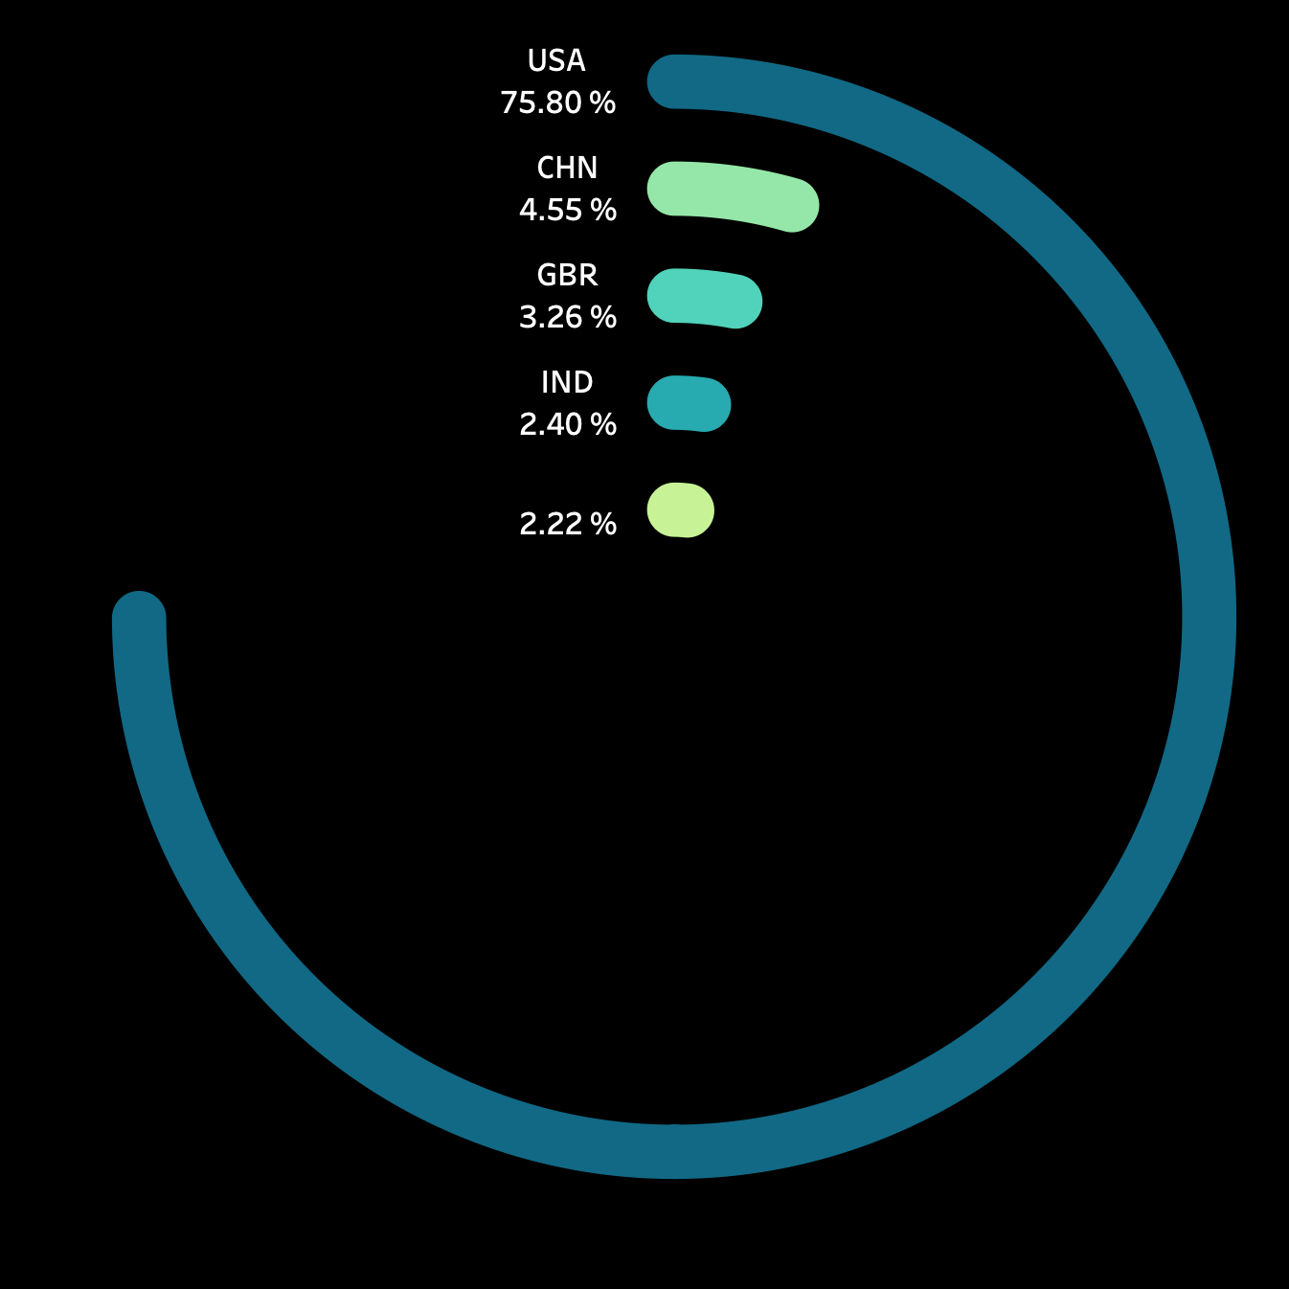
Venture Capital After 2008

Slide 11
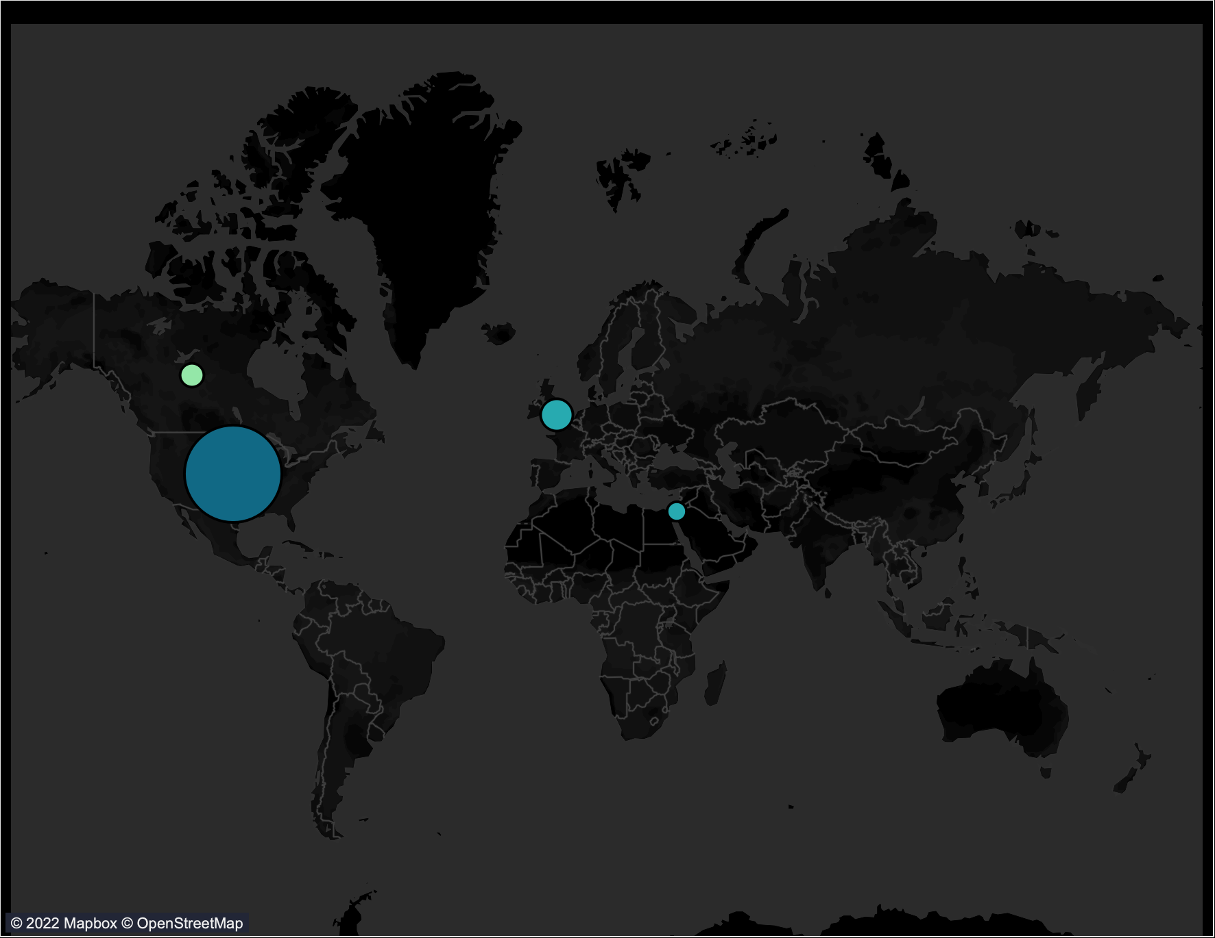
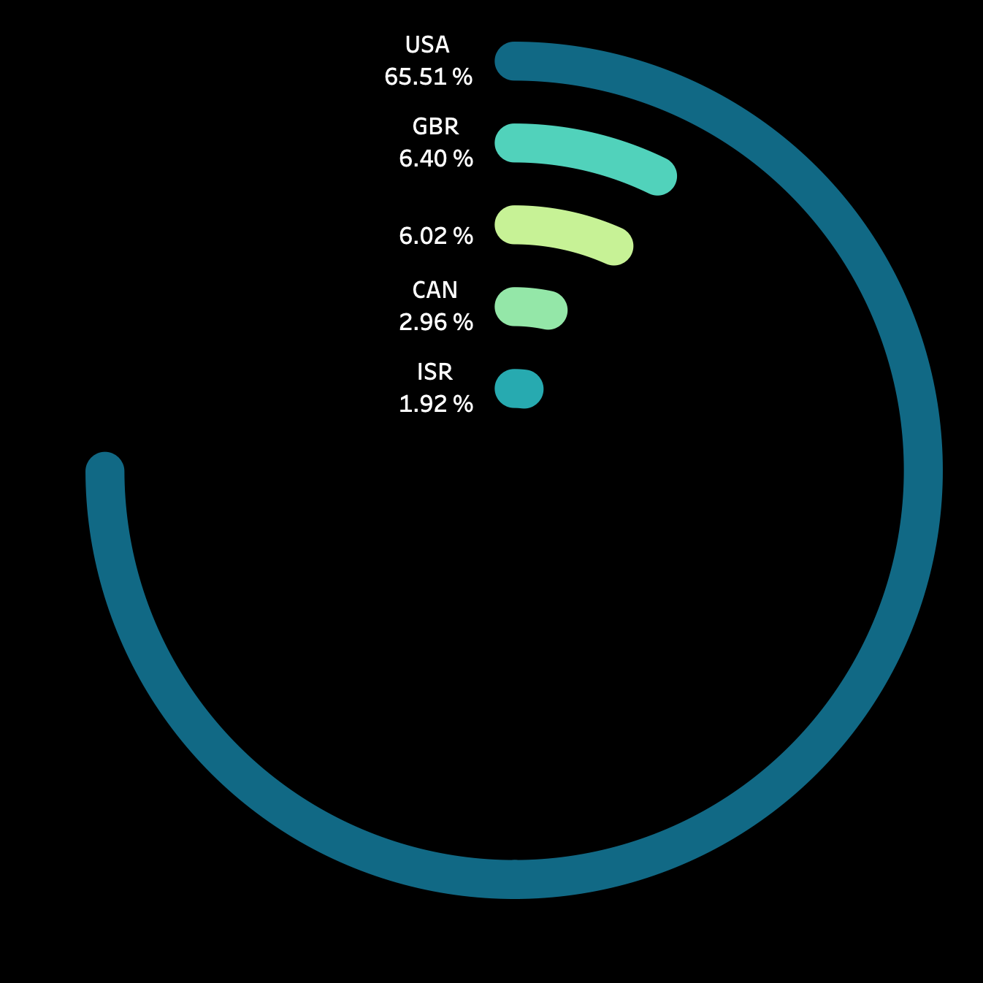
Seed Investments After 2008

Slide 12
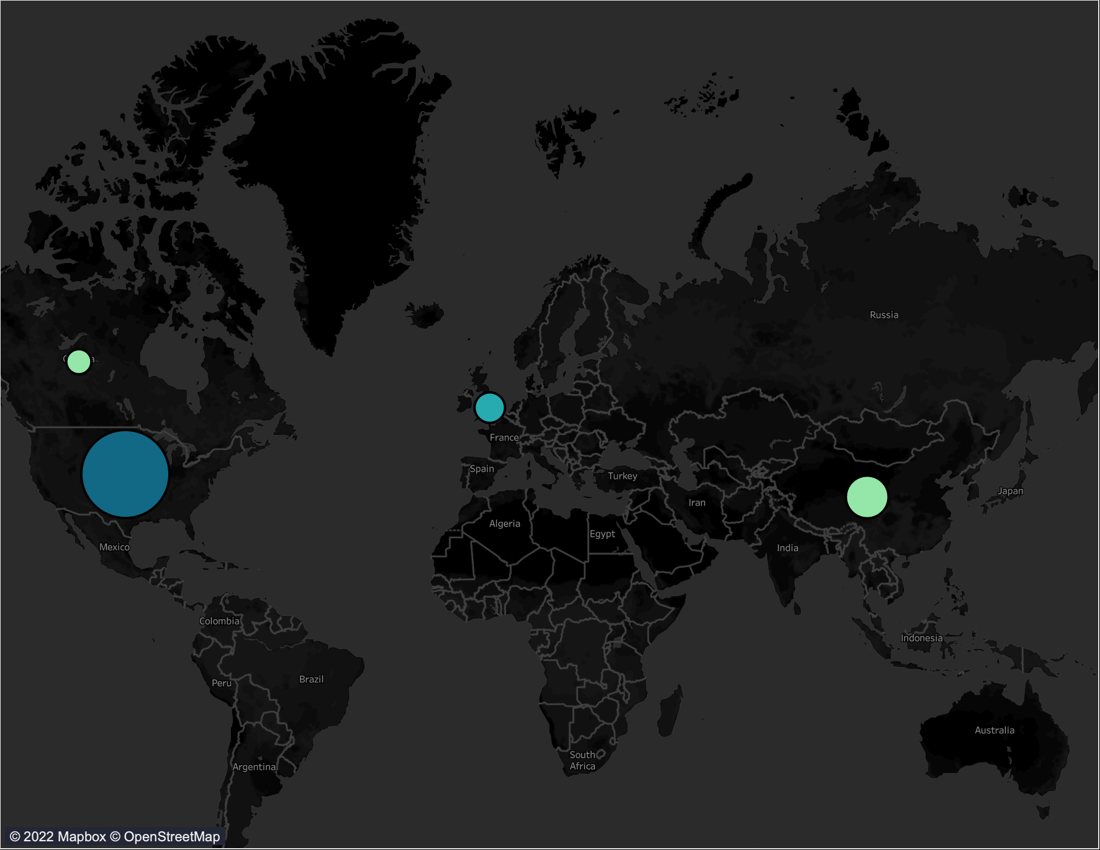
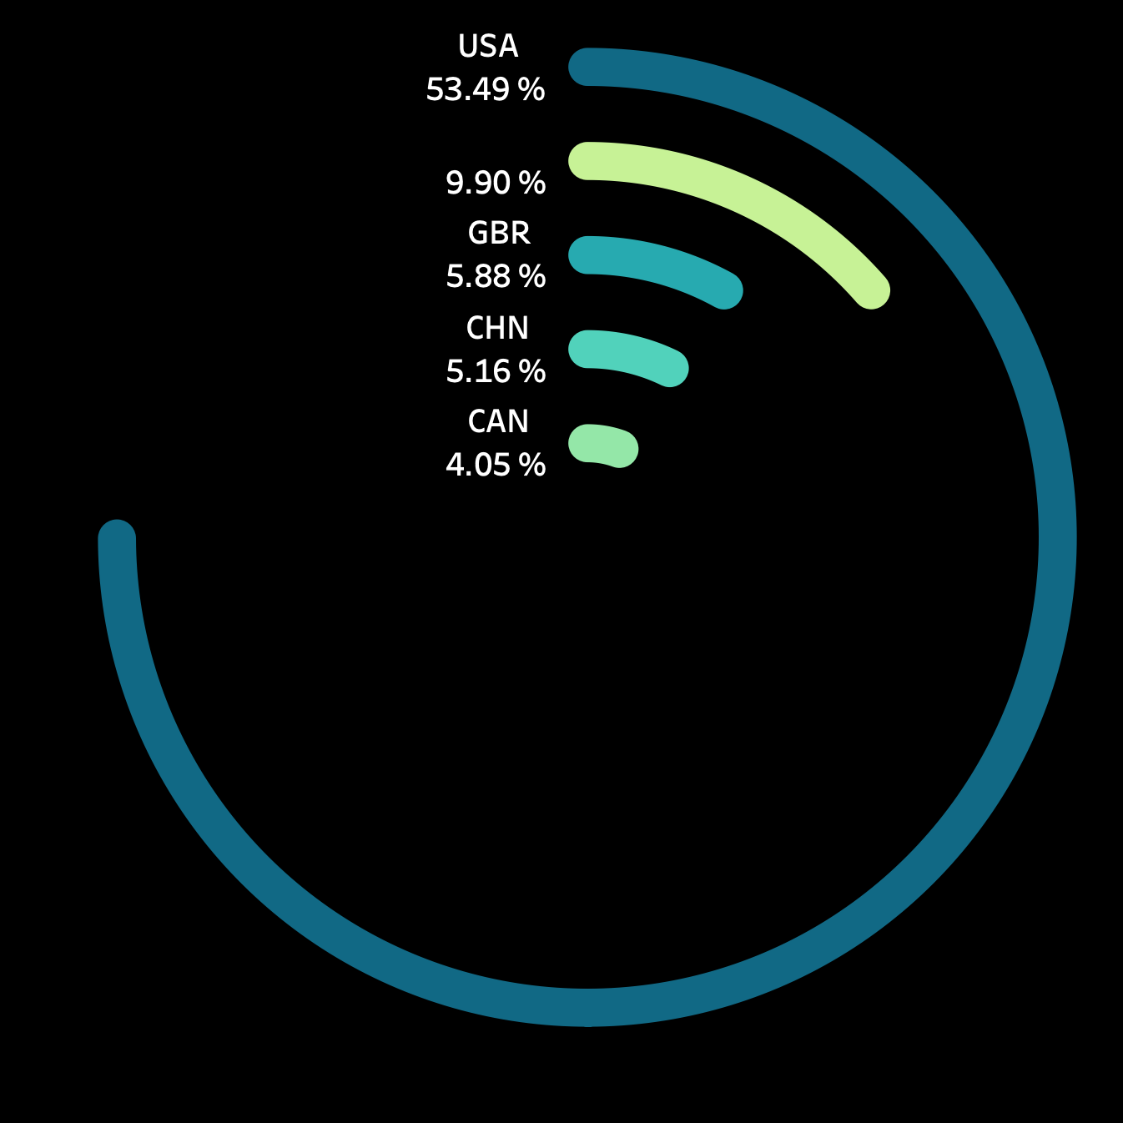
Angel Investments After 2008

Slide 13
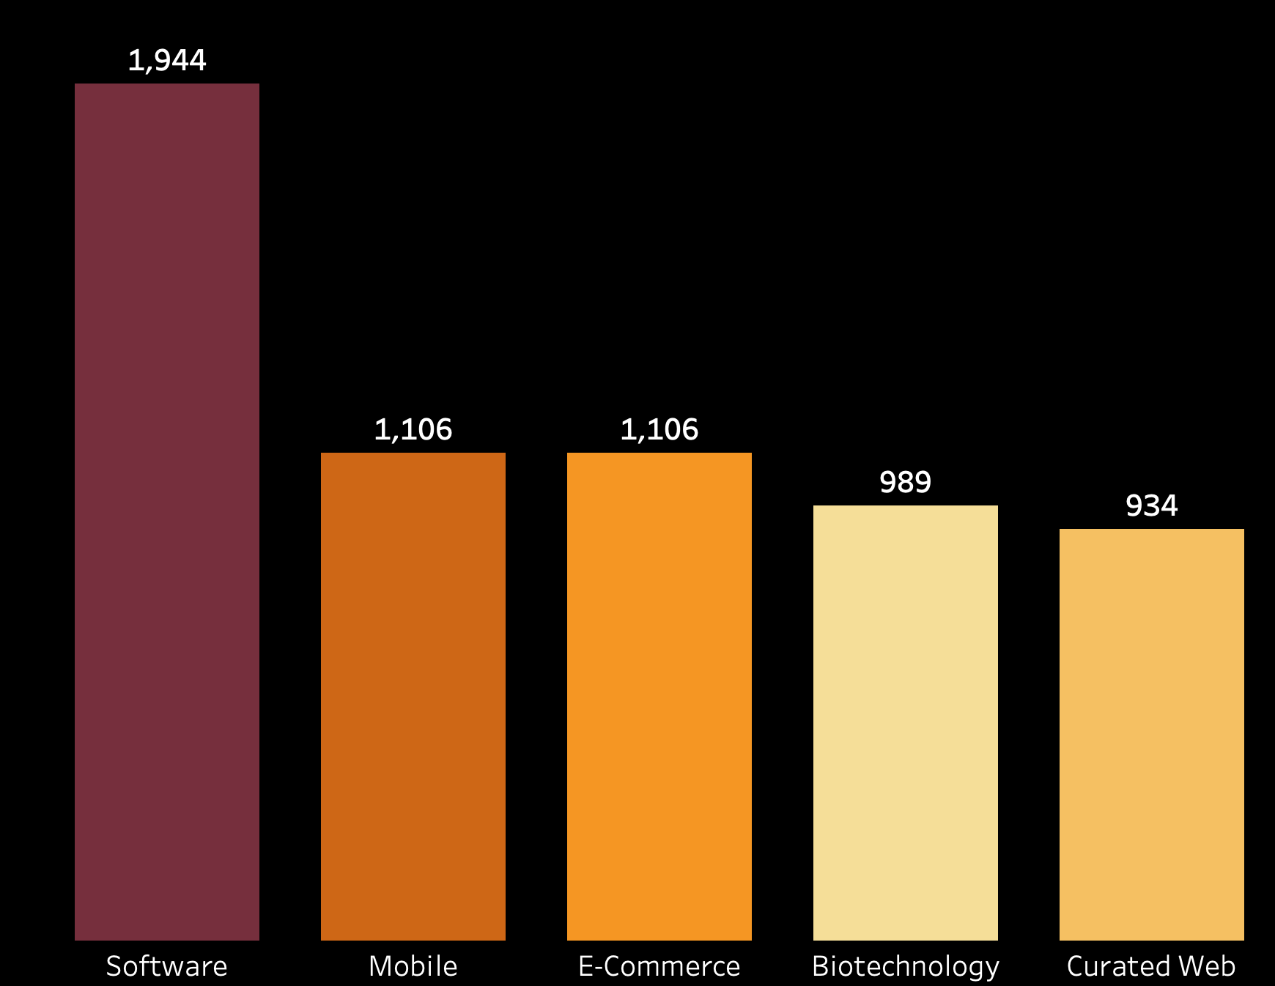
Top 5 Markets after 2008

Slide 14
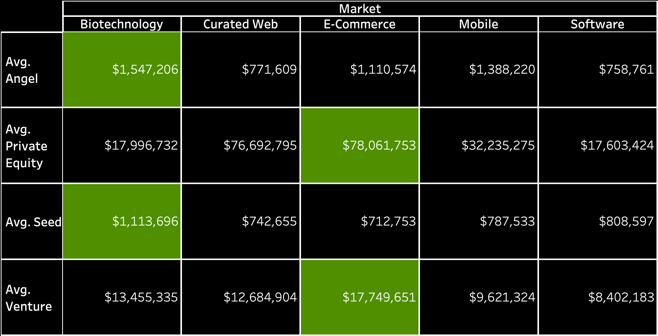
Average Investment for Top 5 Markets After 2008

Slide 15
Key Findings
2000-2014
Top 3 most funded markets 2000-2014: Finance, Internet, Health-Wellness.
Most funded companies: Sberbank, Clearwire, COFCO.
Financial Crisis in 2008.
Post 2008 Market Crash Behavior
Top 5 markets: Software, Mobile, Biotechnology, E-commerce, Curated Web.
Angel Investors financing Biotechnology.
Private Equity/Venture Capital financing E-commerce.
United States, China and United Kingdom with the most investment presence in all investments.

Slide 16
Appendix

Slide 17


Data Cleaning

Slide 18

What is a Startup?
Click To Know More About:
What was the 2008 Market Crash?
Private Equity - Venture Capital - Angel/Seed Investors
Our Data Provider?

Slide 19
Seed Stage
Growth Stage
Exit
($10k - $3M)
Late Stage
($50M +)
Early Stage
($30M approx.)
IPO
($2M - $15M)
REVENUE
Late
Stage
VC
PE
PE
Hedge
Fund
VC
VC
Angel
Angel
Micro
VC
Seed
VC: Venture Capital
PE: Private Equity
IPO: Initial Public Offering
Breakeven
TIME

